Slide 1
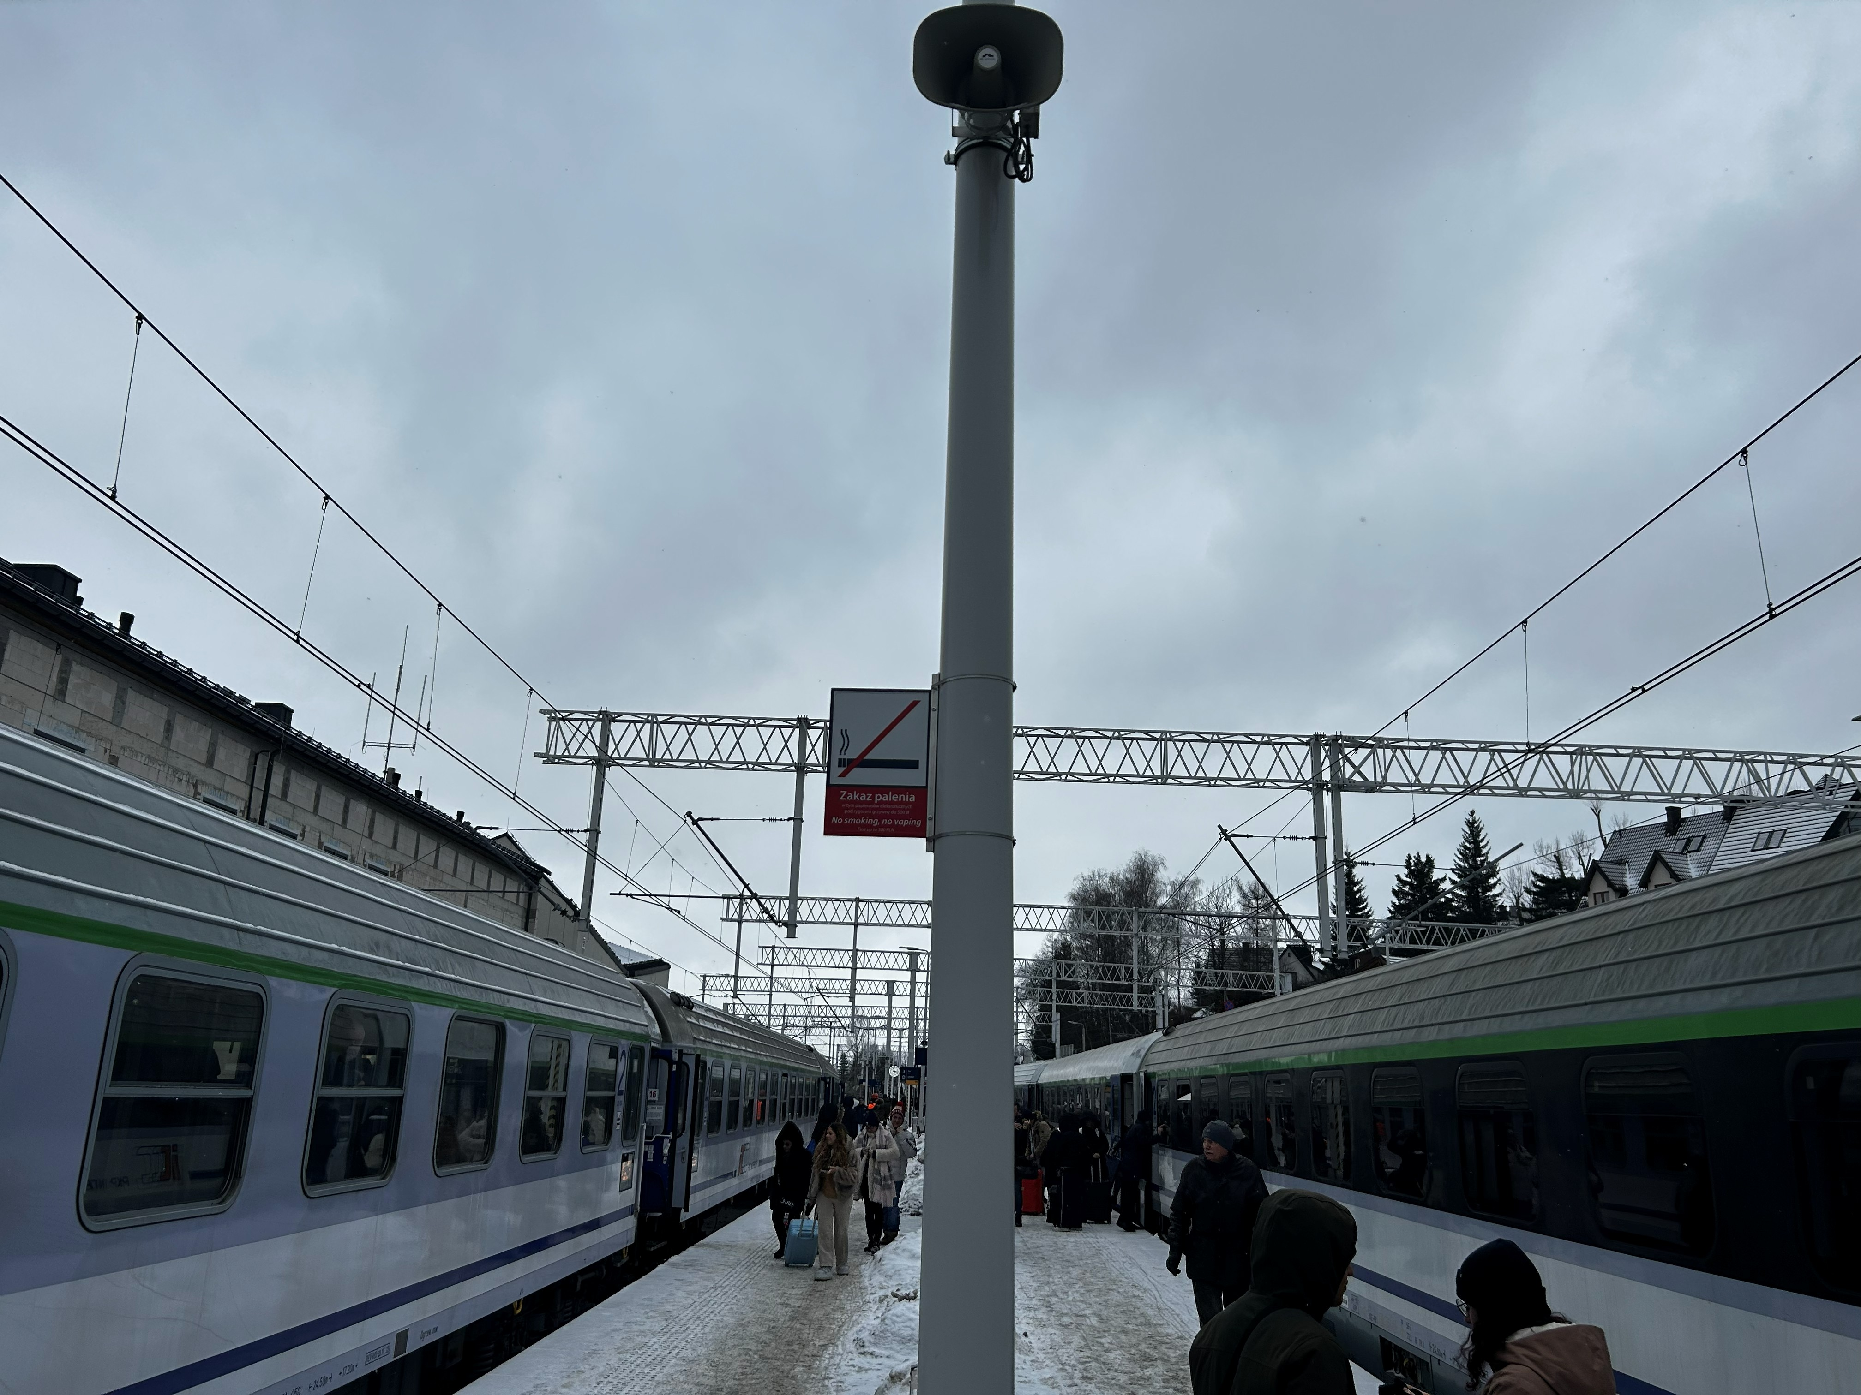
CHUPPACHUP GREEN TRAIN The future of transportation project presentation
Presented by : Trong Minh Khoa Nguyen
UITM – University of information Technology and Management

Slide 2
Agenda
Project Overview
Problem & Solution
Target Users
System Features
Technology Stack
System Architecture
Passenger Module
Admin Module
Database Design
Deployment & DevOps Testing & Validation
Project Management
Conclusion

Slide 3
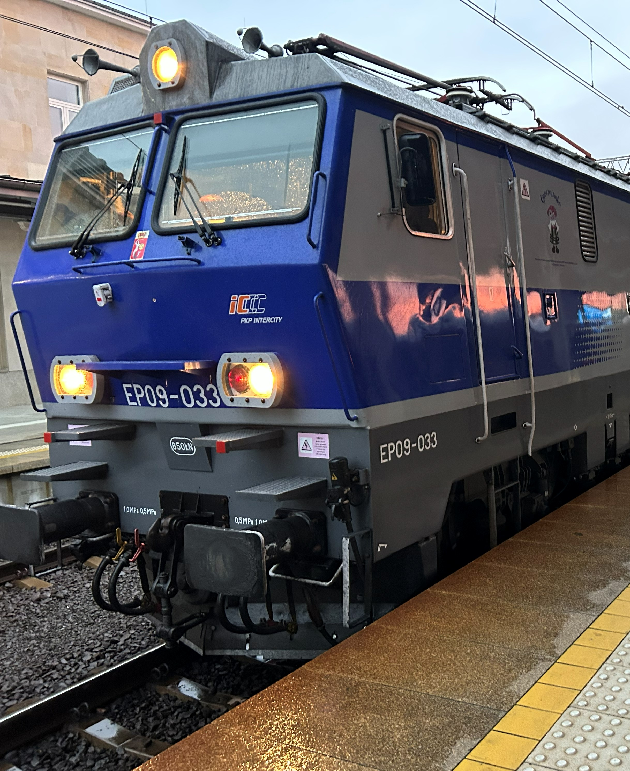
Problem & solution: - Problem: - Traditional ticket booking is - inconvenient - Risk of double booking - Limited discount verification - Fragmented management process Solution: - ChuppaChup Green Train Online ticket booking; - Real-time seat selection - Dynamic pricing - Loyalty system - Administrative dashboard
3

Slide 4


Target Users:
4
Passenger
Search journeys
Select seats
Buy tickets
Use loyalty points
Administrator
Manage trains
Manage schedules
Manage pricing
Verify student cards

Slide 5
Core features:
🔐 Authentication
🚆 Train Search
💺 Seat Selection
💳 Payment Processing
🎁 Loyalty Program
📊 Admin Dashboard

Slide 6
Technology stack
Frontend:
React
Vite
Tailwind CSS
Backend:
Node.js
Express.js
Database:
MongoDB
Mongoose
Security:
JWT
bcrypt
Uploads:
Multer
DevOps:
Azure DevOps
Git

Slide 7
System architecture
React Frontend
│
▼
Express REST API
│
┌──────┴──────┐
▼ ▼
MongoDB File Uploads
(Multer)
Cross-cutting:
JWT Authentication
Role-Based Authorization
Seat Locking Logic

Slide 8
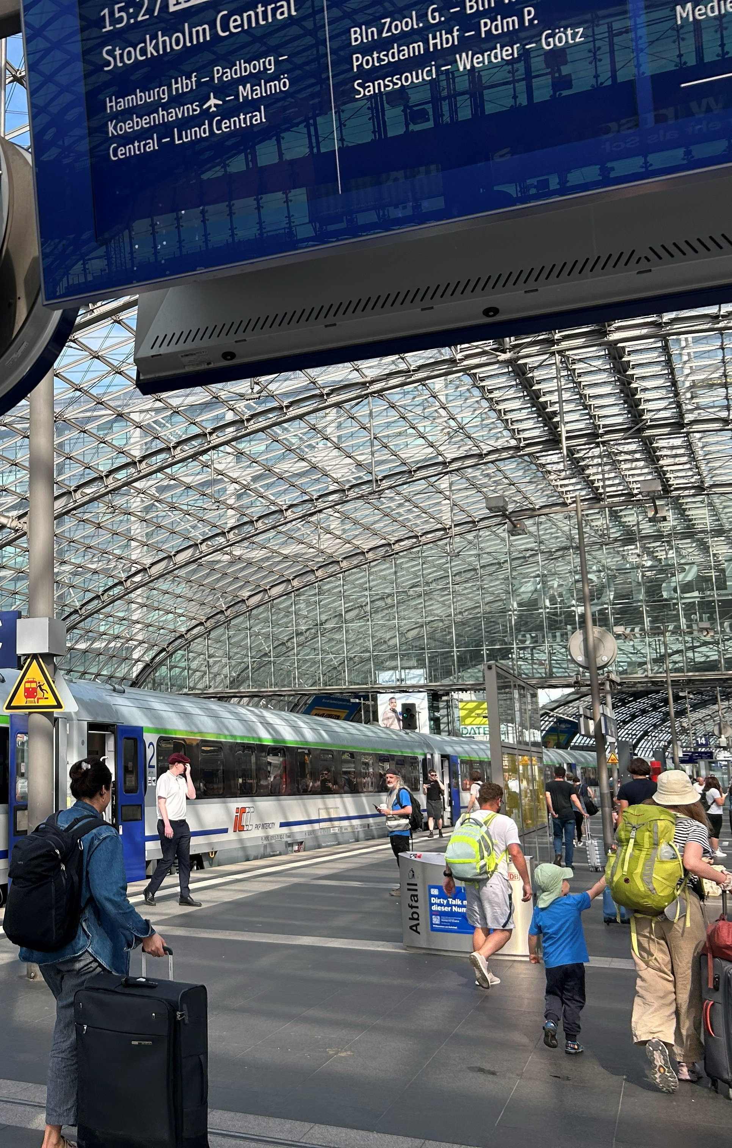
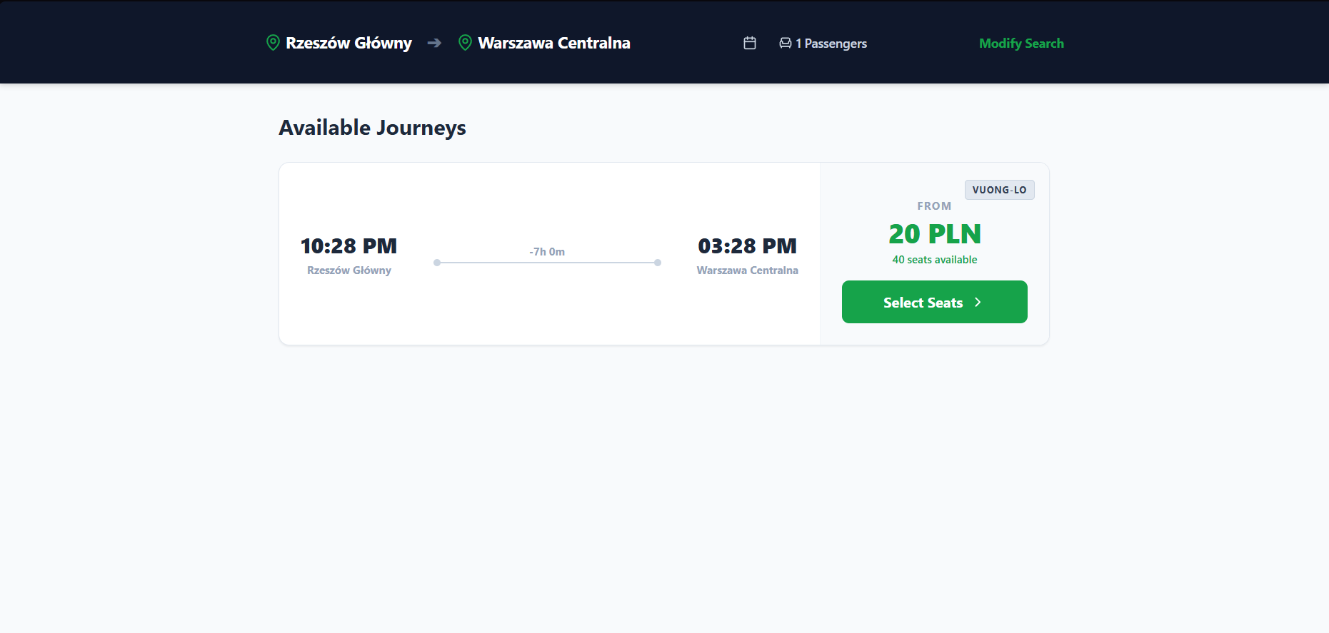
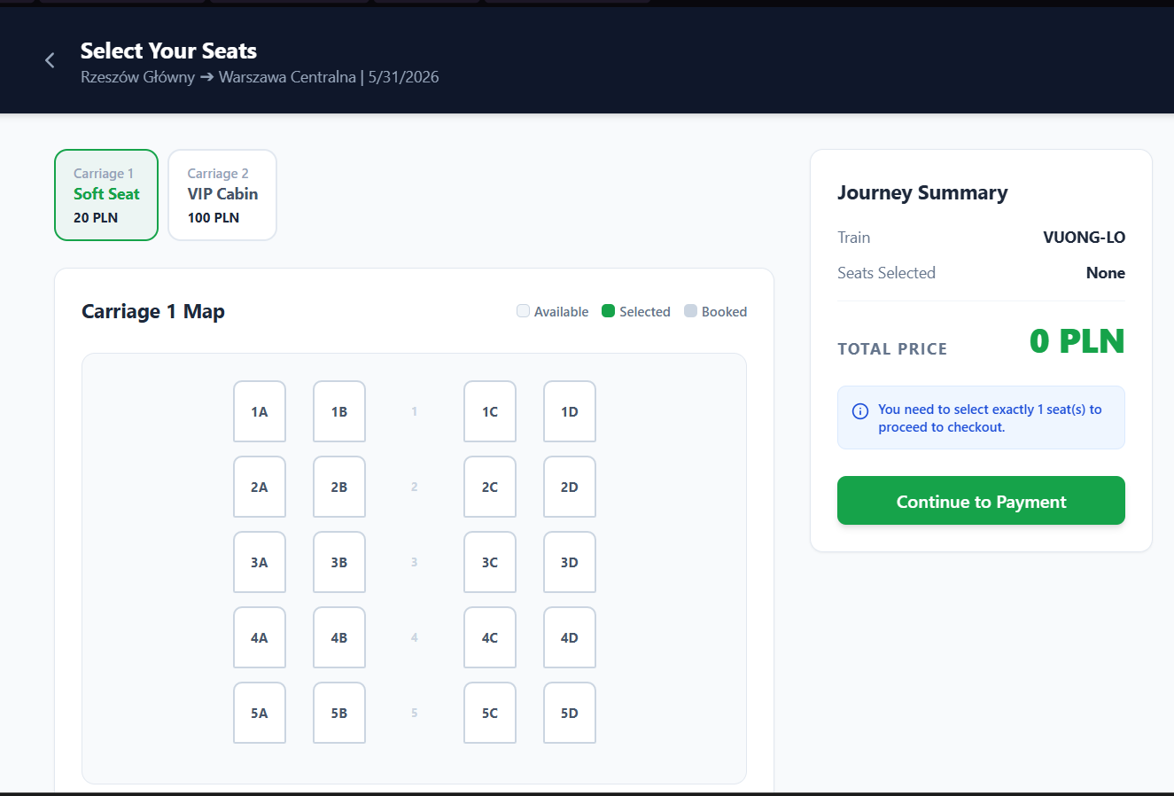
Passenger module:
Features:
Search routes
Select seats
Apply discounts
Redeem loyalty points
View booking history

Slide 9
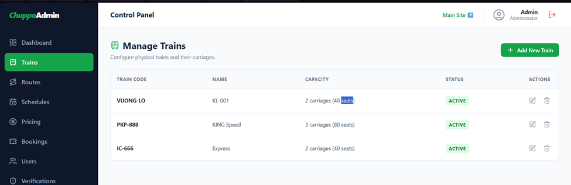
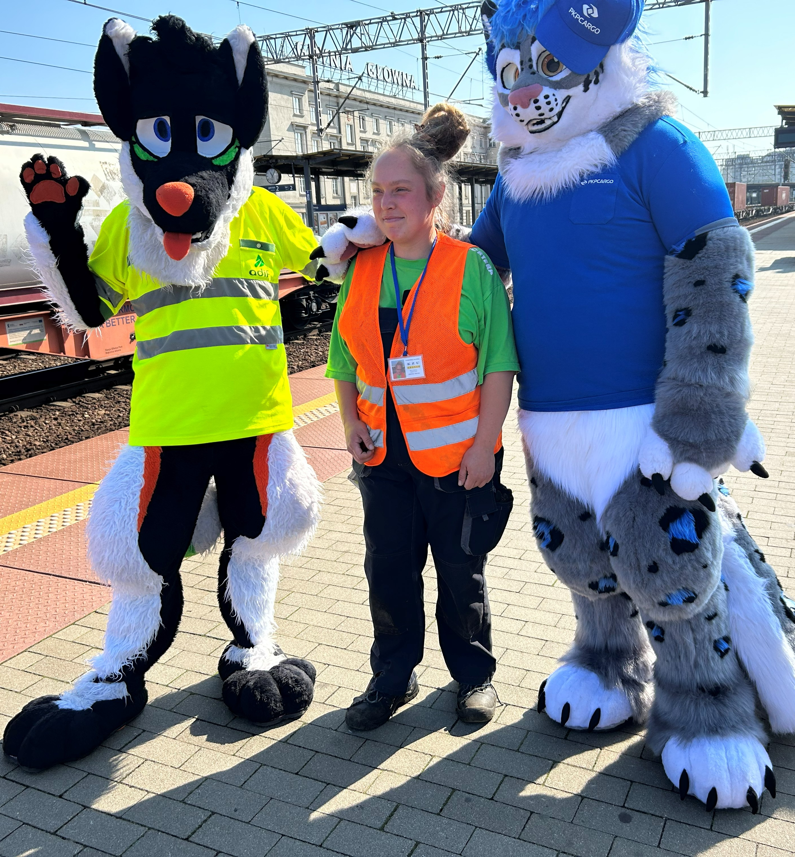
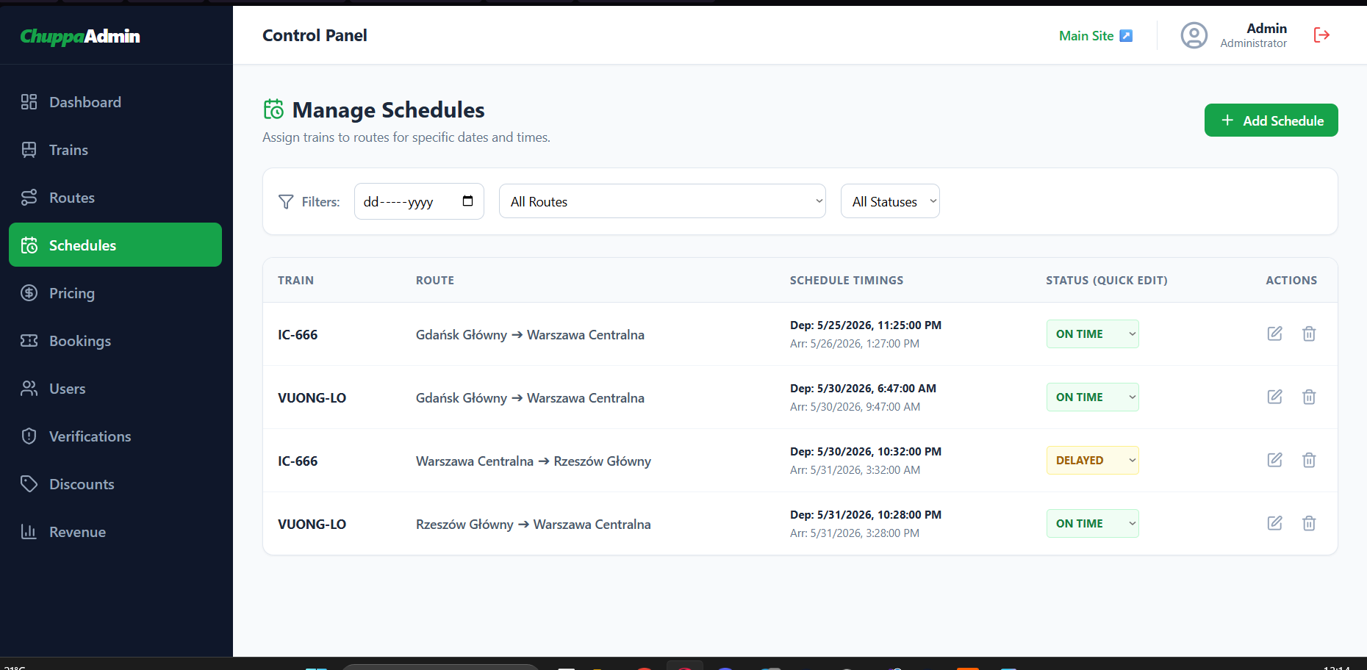
Adminstrator Module:
Functions:
Route management
Schedule management
Pricing rules
Student verification
Revenue monitoring

Slide 10
Database & security
Collection:
Users
Bookings
Transactions
Schedules
Trains
Stations
Security:
Password hashing (bcrypt)
JWT authentication
Protected API routes
Role-based permissions

Slide 11
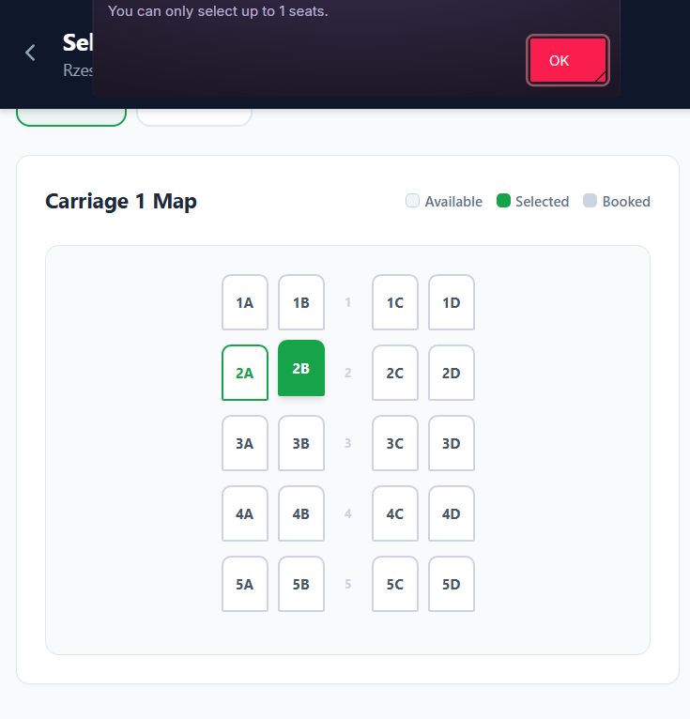
Key Technical Achievement Real-time seat locking
Problem:
Multiple users booking the same seat
Solution:
MongoDB atomic operations
$addToSet
arrayFilters
Result: - No double booking

Slide 12
Testing and validation
- API Testing
JWT validation
UI Testing
Responsive design
- Boundary Testing
Oversized image uploads
Invalid booking data

Slide 13
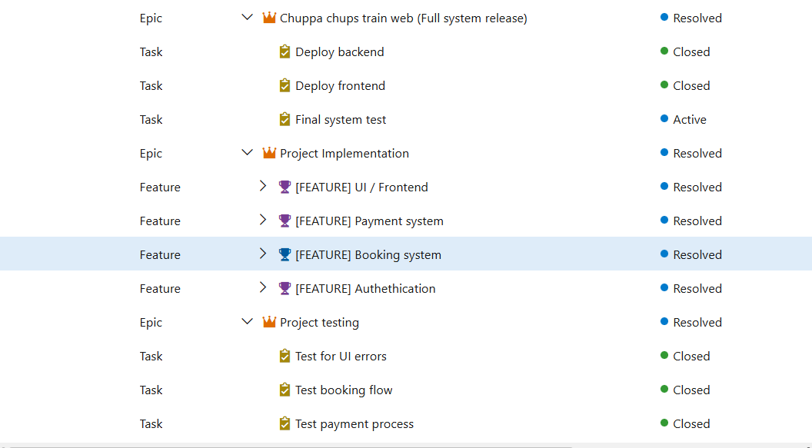
Azure DevOps & Project Management:
Waterfall Phases : | Azure Devops :
1. Requirement | Epics
2. Design | Features
3. Implementation | Tasks
4. Testing | Bug Tracking
5. Deployment

Slide 14
Conclusion
Achievements:
Full MERN Stack Implementation
Dynamic Pricing
Loyalty Points
Admin Dashboard
Secure Authentication
Real-Time Seat Reservation
ChuppaChup Green Train successfully modernizes train ticket booking through a secure, scalable, and user-friendly web platform.
Future Improvements:
Real payment gateway integration
Email ticket generation
Mobile application
AI-powered recommendations

Slide 15
Thank you
Trong Minh Khoa Nguyen
+48 694 295 202
72855@student.edu,wsiz.pl

